Slide 1
Minimalism, Conceptual Art & Post-Minimalism
“The sensuous object, resplendent with compressed internal relations has had to be rejected.”
Robert Morris
Recommended reading: Michael Fried, “Art and Objecthood” (excerpt); Sol Lewitt, “Sentences on Conceptual Art”; Martha Rosler, “Statement,” available on “Readings” page of Art 112/212 course website

Slide 2
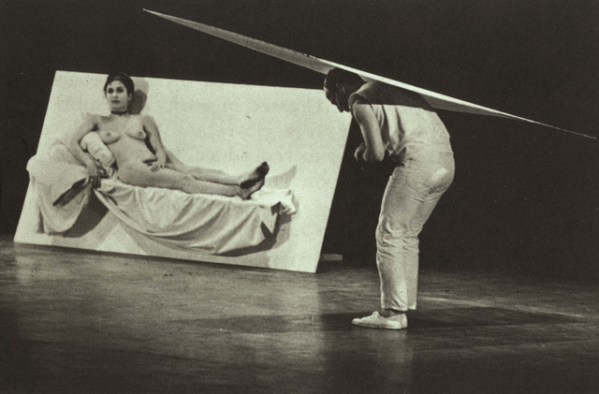
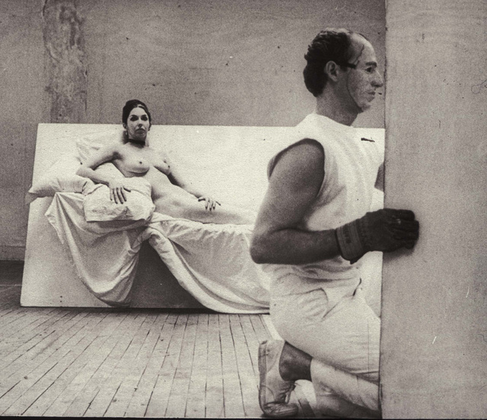
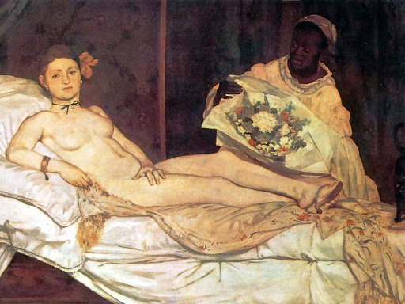
Robert Morris and Carolee Schneeman, Site, 1964, performance, New York (compare: below, left) Edouard Manet, Olympia, 1863 (avant-garde icon)
Morris’s mask is by Jasper Johns

Slide 3
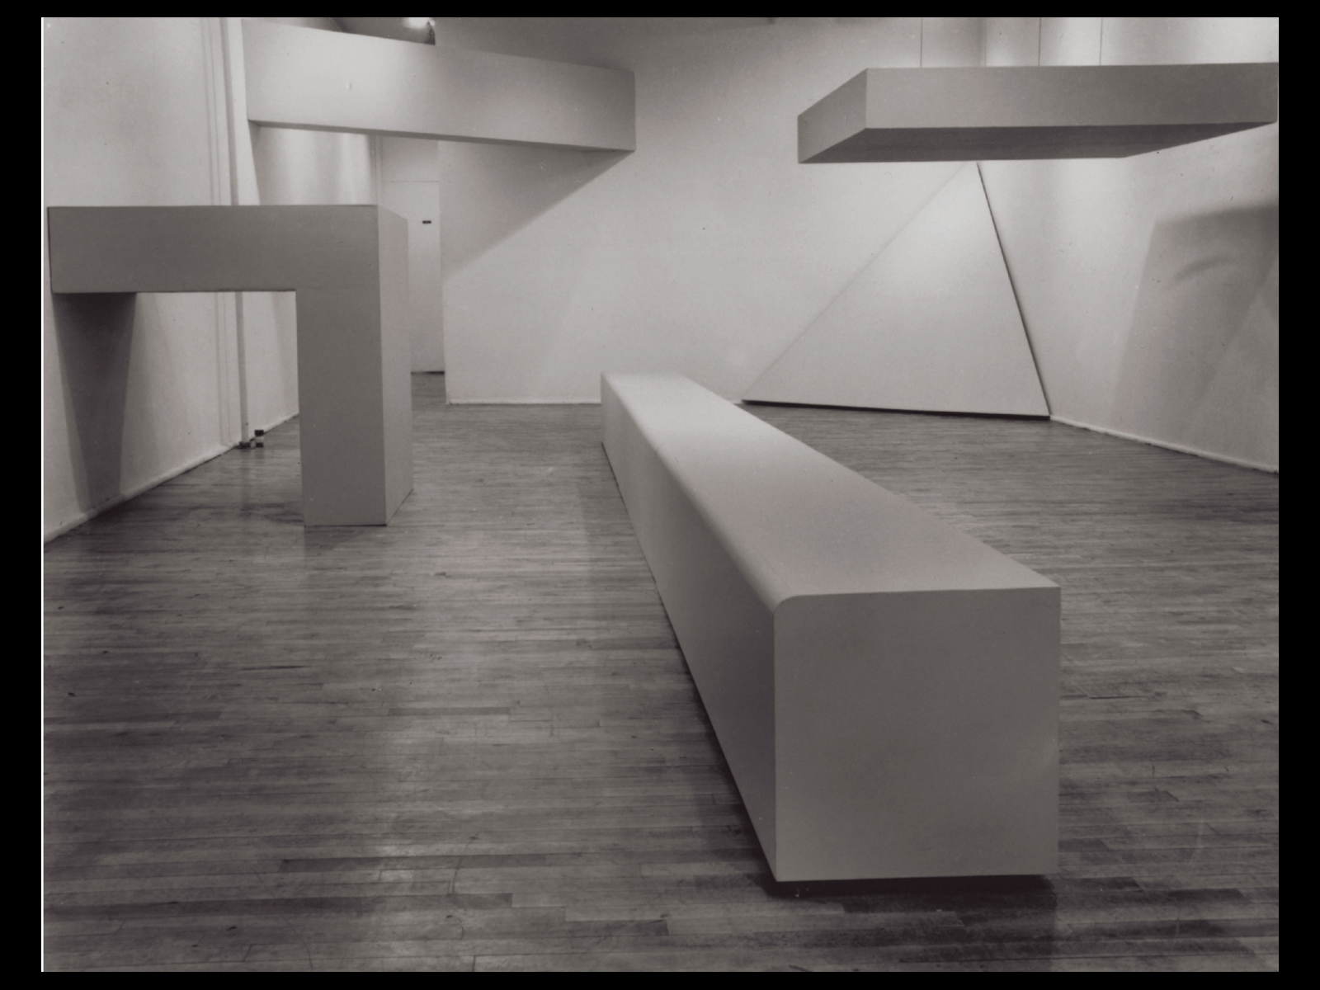
Robert Morris, Green Gallery Installation. Seven painted plywood sculptures
at the Green Gallery, New York, 1964.
Notes:
1.6 Robert Morris, Green Gallery Installation. Seven painted plywood sculptures at the Green Gallery, New York, 1964. Varying dimensions. Courtesy Leo Castelli Gallery, New York.

Slide 4
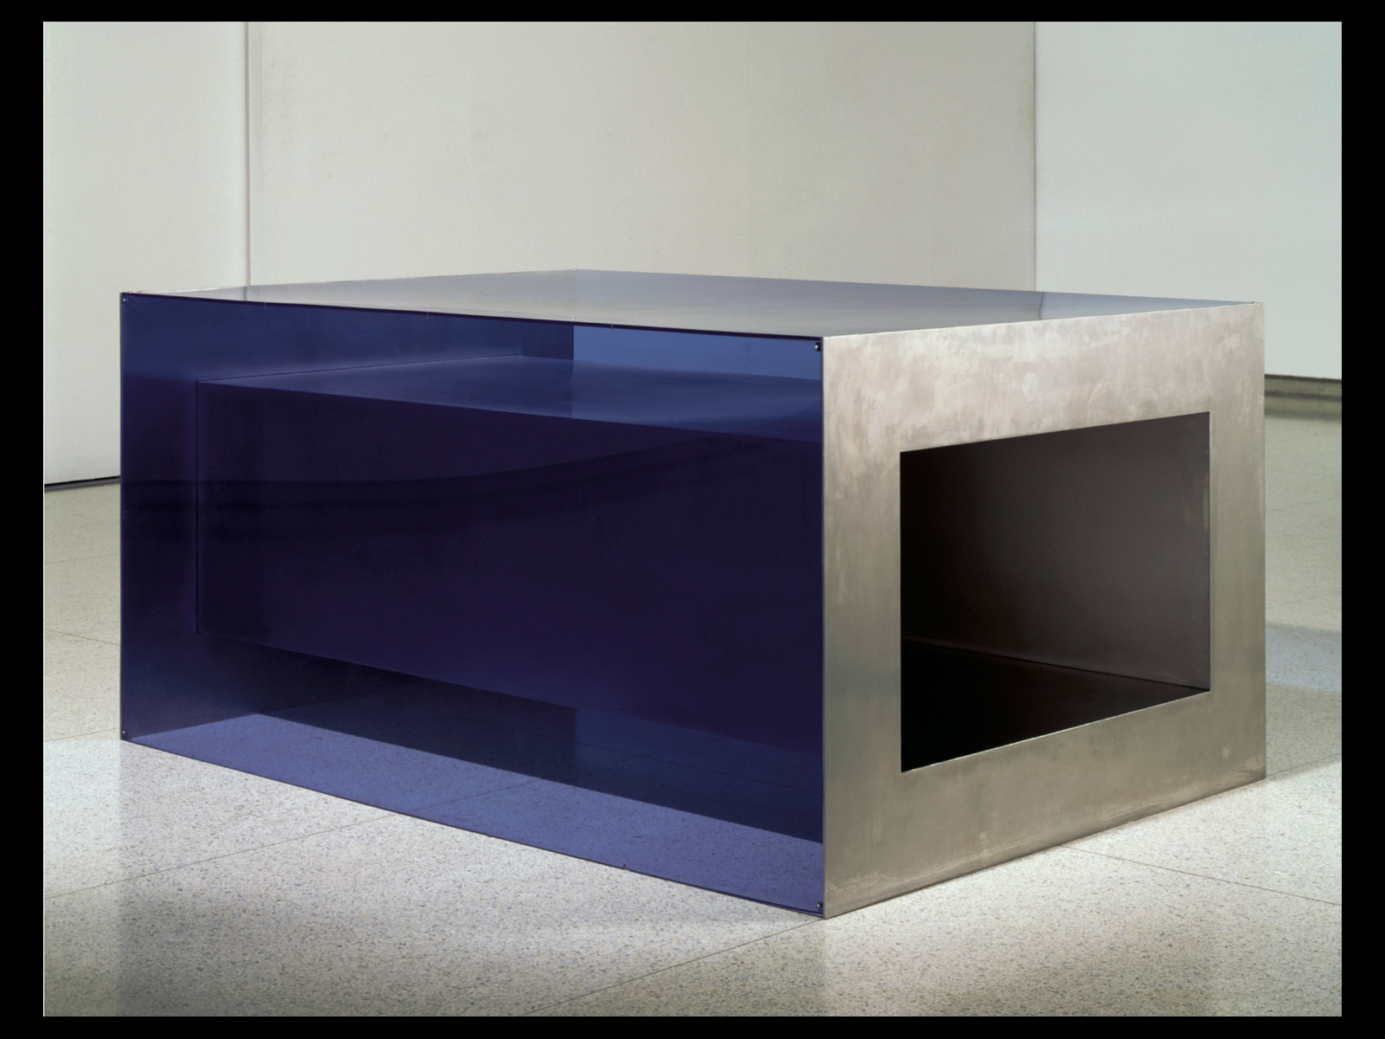
Donald Judd, Untitled, 1968, stainless steel, plexiglass, overall 33 x 68 x 48"
Notes:
1.5 Donald Judd, Untitled, 1968. Stainless steel, plexiglass, overall 33 x 67 7∕8 x 48" (83.82 x 172.4 x 121.92 cm). From the exhibition “Art in Our Time: 1950 to the Present,” Walker Art Center, Minneapolis, 5 September 1999 to 2 September 2001. Collection Walker Art Center.

Slide 5
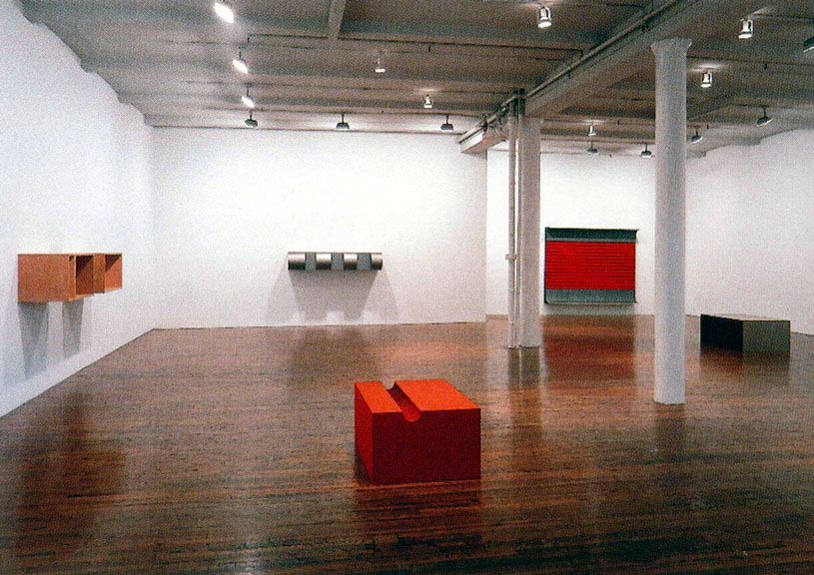
The essence of sculpture is its reliance on space: “a work can be as powerful as it can be thought to be. . . . Actual space is intrinsically more powerful and specific than paint on a flat surface… A work need only be interesting” (Donald Judd)
Theatricality and the “end” of Greenbergian modernism

Slide 6
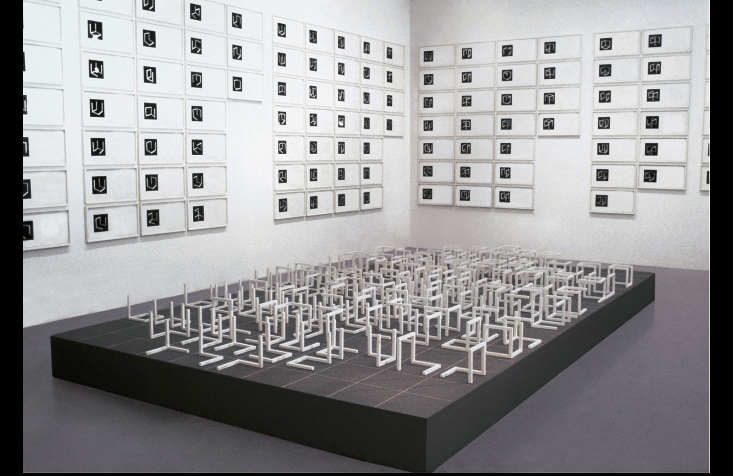
Sol LeWitt, Variations of Incomplete Open Cubes, 1974. Wood sculptures with white paint (122 pieces), each piece 8” (20.3 cm) square. Framed photographs and drawings (131 pieces), each piece 26 x 14”. Base 12 x 120 x 216"

Slide 7
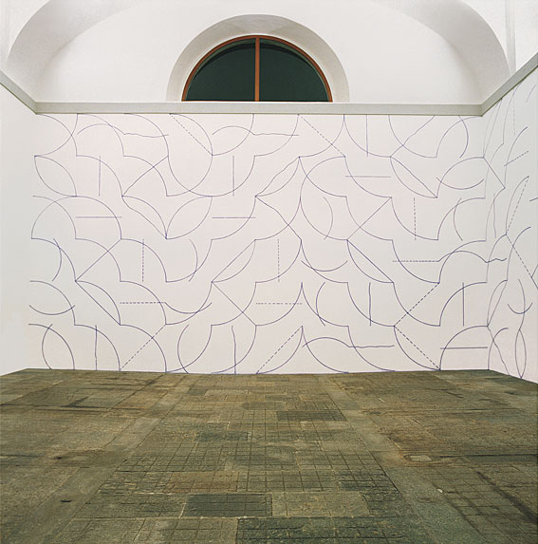
Lewitt, Wall Drawing #146, September 1972. All two-part combinations of blue arcs from corners and sides and blue straight, not straight, and broken lines; blue crayon, Dimensions vary with installation.

Slide 8
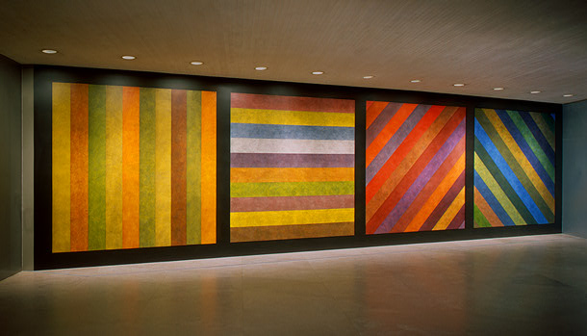
Sol LeWitt, Wall Drawing No. 681 C / A, 1993 Instructions: wall divided vertically into four equal squares separated and bordered by black bands. Within each square, bands in one of four directions, each with color ink washes superimposed, 120 x 444 in.

Slide 9
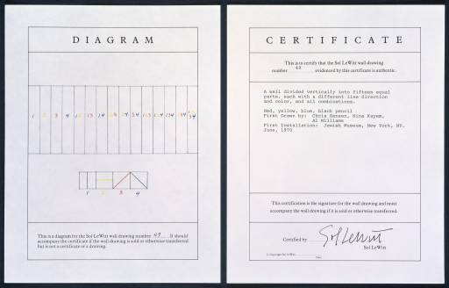
Lewitt, A Wall Divided Vertically into Fifteen Equal Parts, Each with a Different Line Direction and Color, and All Combinations 1970 "In conceptual art the idea or concept is the most important aspect of the work . . . all planning and decisions are made beforehand and the execution is a perfunctory affair. The idea becomes the machine that makes the art." Sol LeWitt: "Paragraphs on Conceptual Art," Artforum, summer issue, 1967

Slide 10
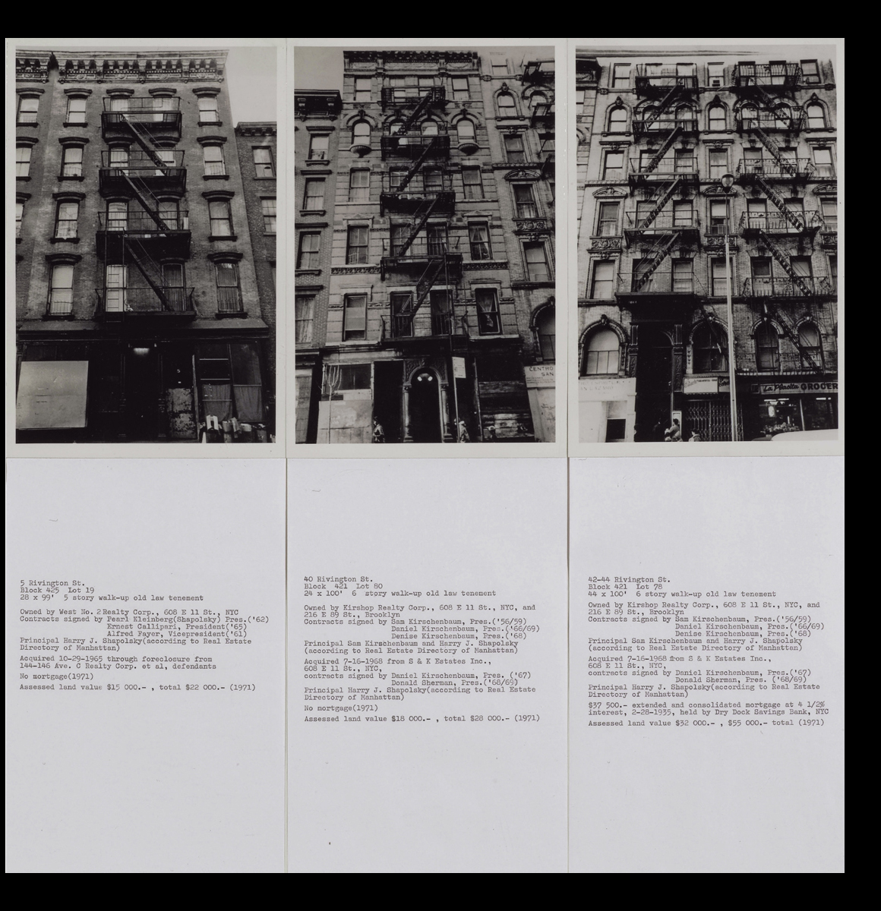
Hans Haacke, Shapolsky et al., Manhattan Real Estate Holdings, a Real-Time Social System, as of May 1, 1971, 1971.
Showing three of 33 panels; 146 black and white photographs, 146 typewritten pages, 2 plans, 6 tables of transactions, 1 explanatory panel. La Musée National d'Art Moderne, Centre Georges Pompidou, Paris.
Notes:
1.18 Hans Haacke, Shapolsky et al., Manhattan Real Estate Holdings, a Real-Time Social System, as of May 1, 1971, 1971. Showing three of 33 panels; 146 black and white photographs, 146 typewritten pages, 2 plans, 6 tables of transactions, 1 explanatory panel. La Musée National d'Art Moderne, Centre Georges Pompidou, Paris.

Slide 11
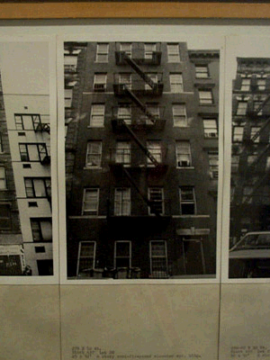
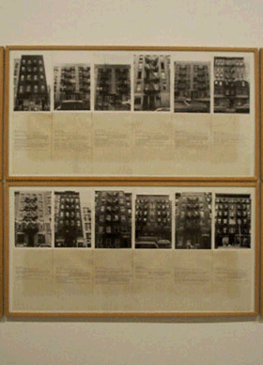
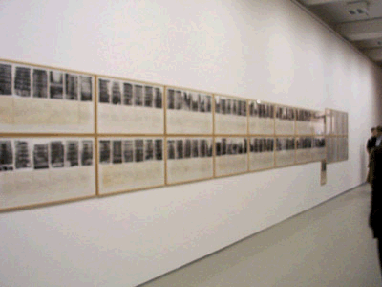
Hans Haacke (German, b.1936), Shapolsky et al. Manhattan Real Estate Holdings, a Real-Time System, as of May 1, 1971, 1971: 142 photographs of New York apartment buildings, 2 maps of New York's Lower East Side and Harlem with properties marked, 6 charts documenting business relations within the real estate group.

Slide 12
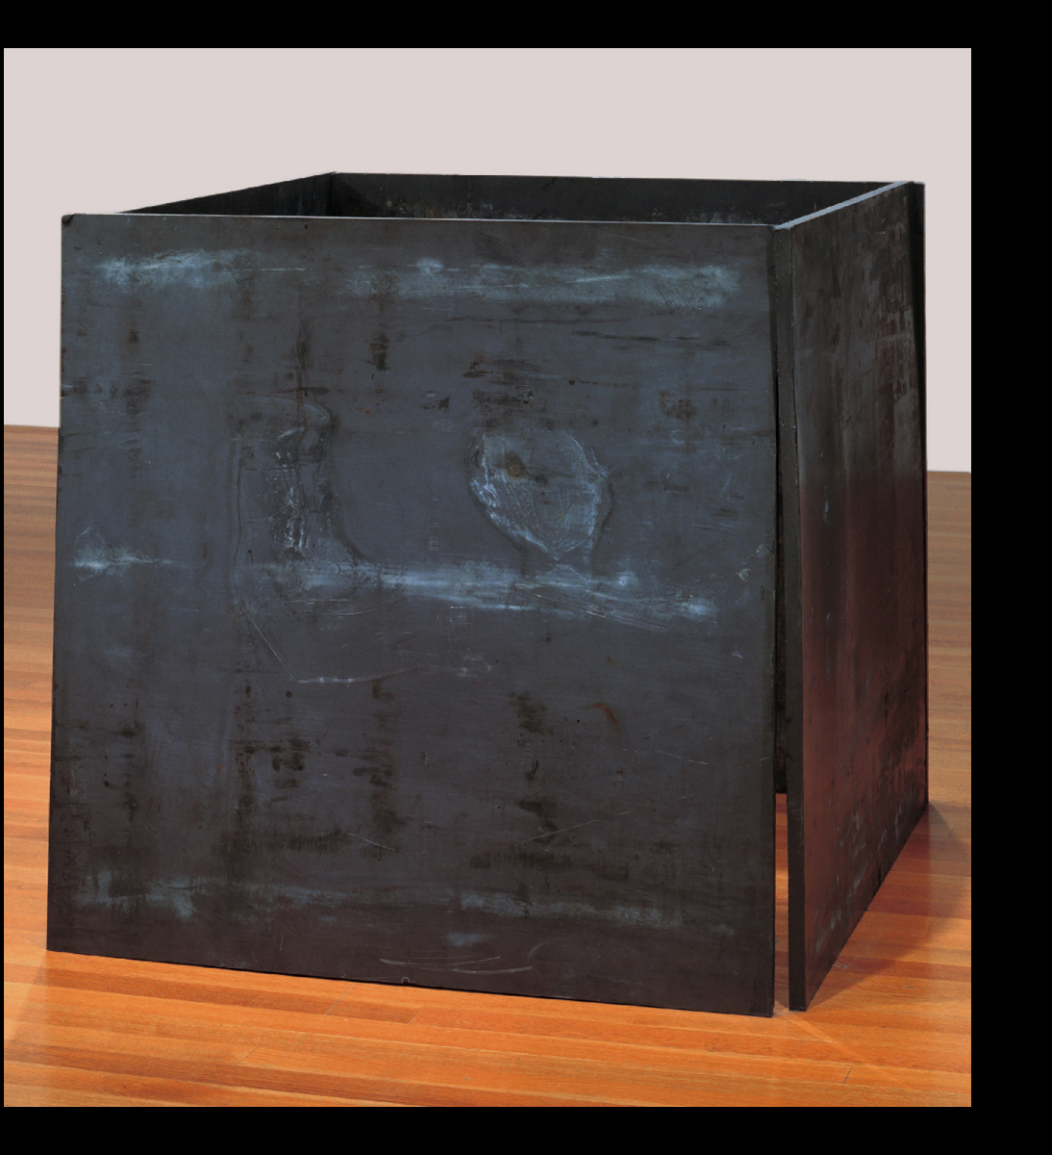
Richard Serra, Prop, 1968. Lead antimony, four plates, each 48 x 48 x 1“. The Museum of Modern Art, New York.
Post-Minimalism
Notes:
1.11 Richard Serra, Prop, 1968. Lead antimony, four plates, each 48 x 48 x 1" (122 x 122 x 2.5 cm). The Museum of Modern Art, New York. Gift of the Grinstein Family. Acc. num. 286.1986.a-d.

Slide 13
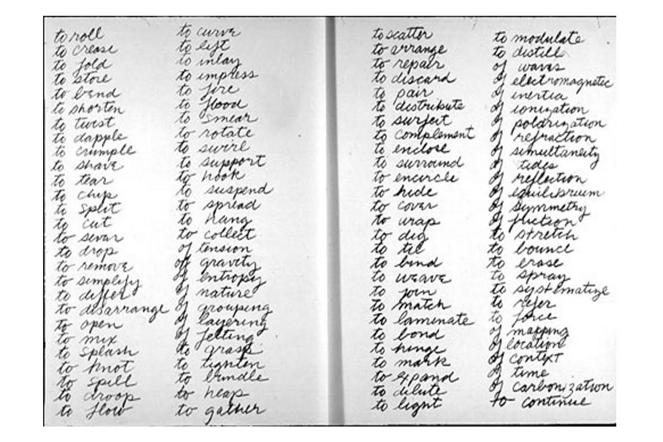
Richard Serra, Verb List, pencil on two sheets of paper, 1962-8, “Drawing is a verb… [the list is] a series of actions to relate to oneself, material, place, and process.” Serra listed the infinitives of 84 verbs and 24 possible contexts – of gravity, of entropy, of nature, etc. – in four columns of script.

Slide 14
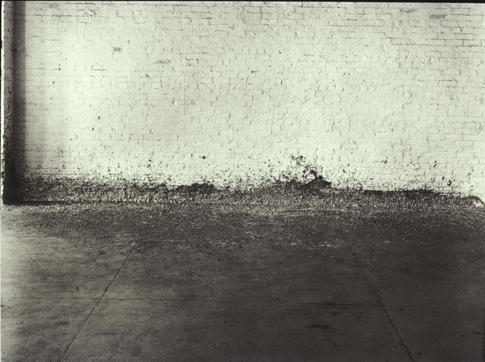
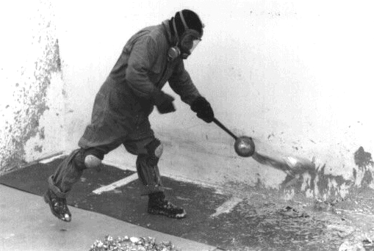
Richard Serra (b. 1939, US), Splashing, 1968, molten lead left to harden, Leo Castelli warehouse. Action / Process Sculpture

Slide 15
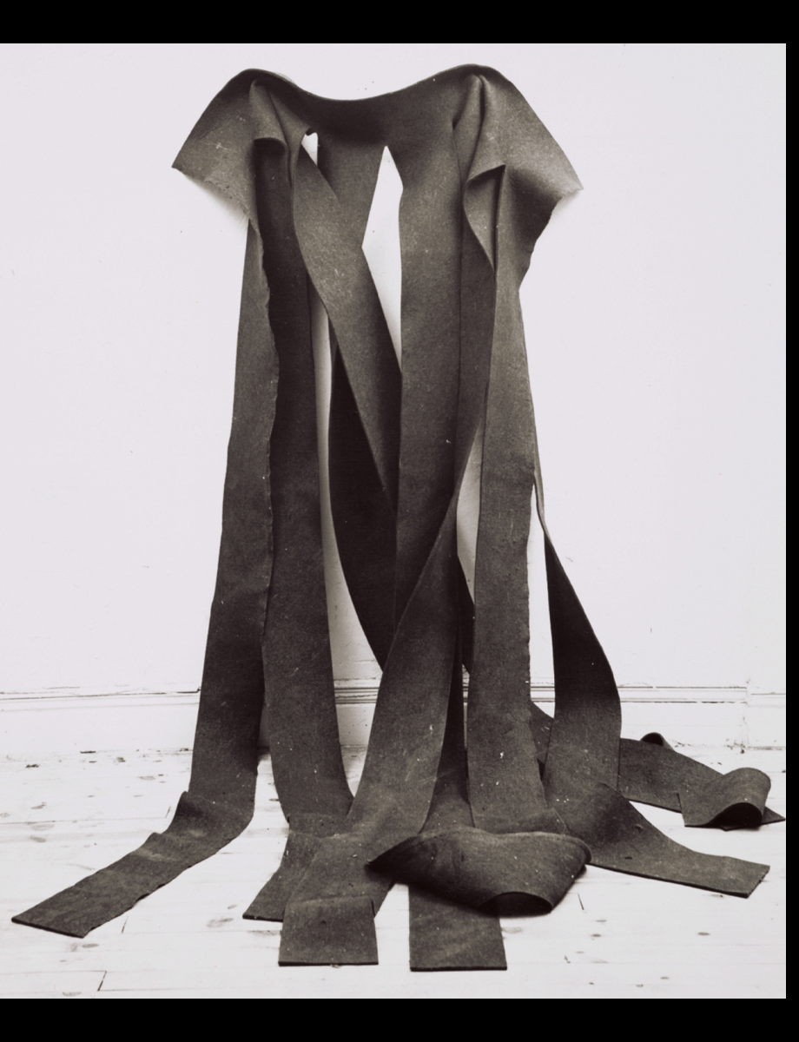
Robert Morris, Untitled, 1967. Felt, 12 x 6' (3.65 m x 182.88 cm). Archives of American Art, Smithsonian Institution
Post-Minimalism, process art employing chance and gravity
Notes:
1.10 Robert Morris, Untitled, 1967. Felt, 12 x 6' (3.65 m x 182.88 cm). Archives of American Art, Smithsonian Institution. Collection of Ellen Johnson. Photo Rudy Burckhardt.

Slide 16
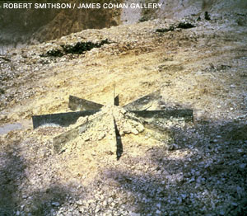
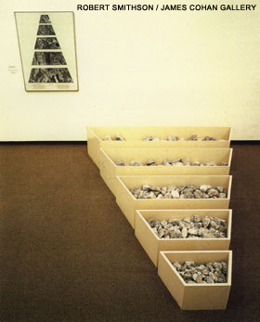
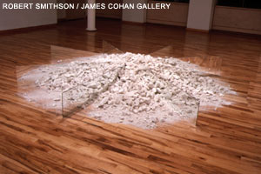
Robert Smithson (US, 1938-1973), A Nonsite: Franklin, New Jersey, summer, 1968 wood, limestone, aerial photographs, 16 1/2" x 82" x 110“ (right top and bottom) Chalk and Mirror Displacement, 1969, 6 mirrors / chalk from quarry in Oxted, England, each 10"x 5" (overall 10‘)

Slide 17
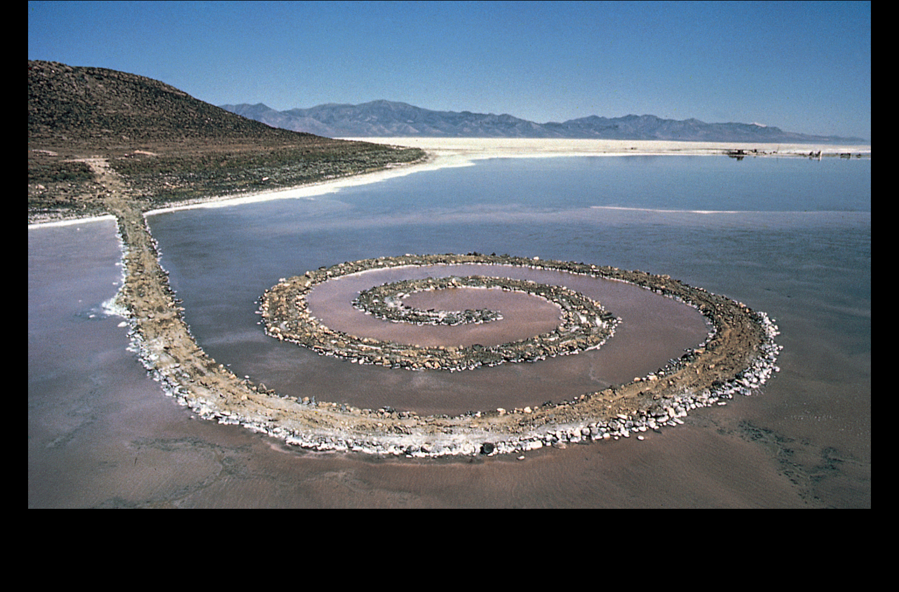
Robert Smithson, Spiral Jetty, 1970. Black basalt, limestone rocks, earth, and salt crystals, length 1,500’ (457.2 m). Great Salt Lake, Utah.
Notes:
1.12 Robert Smithson, Spiral Jetty, 1970. Black basalt, limestone rocks, earth, and salt crystals, length 1,500’ (457.2 m). Great Salt Lake, Utah. Photograph by Gianfranco Gorgoni, courtesy John Weber Gallery, New York.

Slide 18
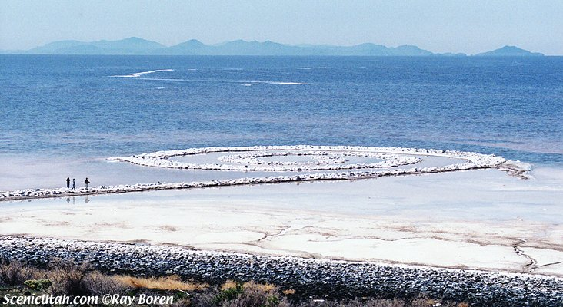
Robert Smithson (US, 1938-1973) Spiral Jetty, 1970, Great Salt Lake, black rocks, salt crystals, Dia foundation collection

Slide 19
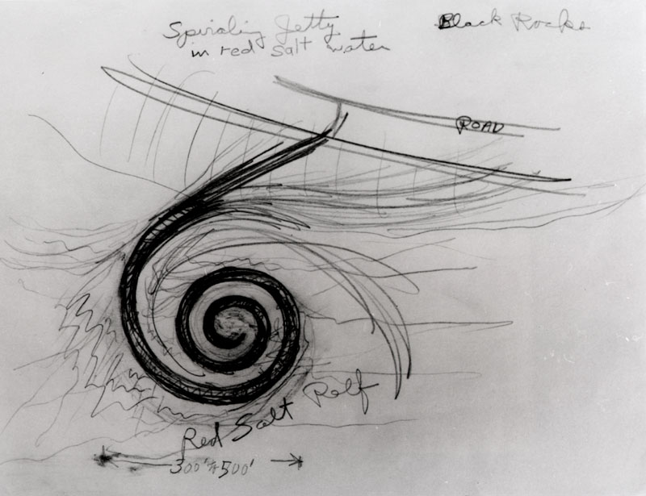
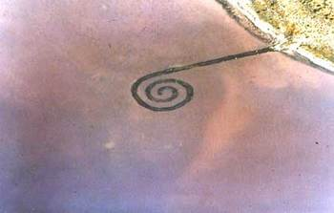
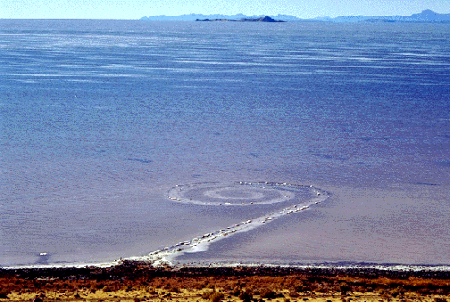

Slide 20
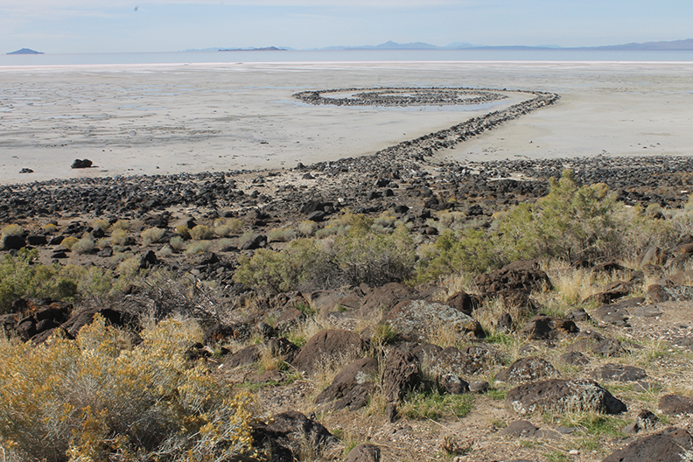
Summer 2015 photo by Danny Cardenas
Go to Google Earth for location and current condition (dry) of the lake

Slide 21
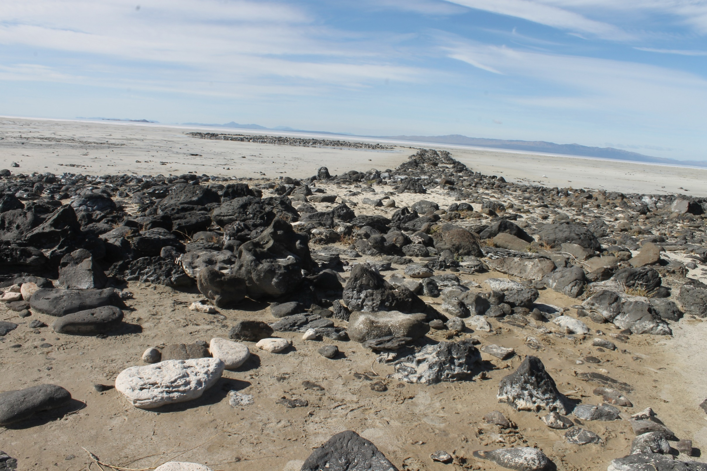
Summer 2015 photo by Danny Cardenas

Slide 22
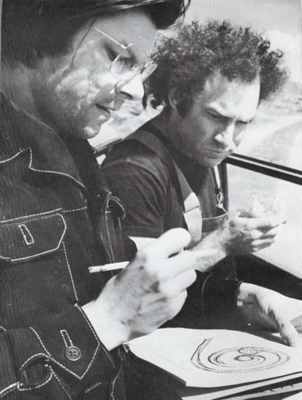
Robert Smithson (left) and Donald Judd (right) at site of Spiral Jetty, 1970 Minimalism – Post-Minimalism

Slide 23
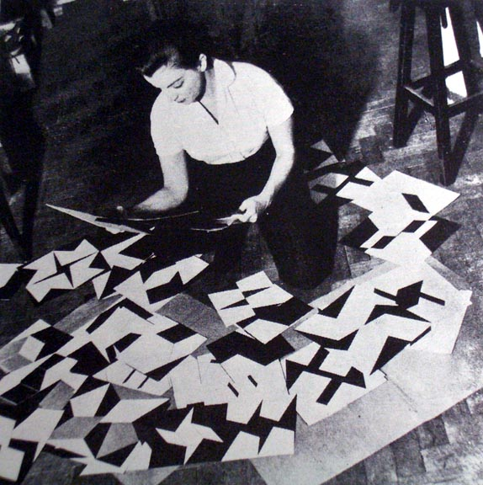
Lygia Clark (Brazil, 1920-1988) Rio de Janeiro 1958

Slide 24
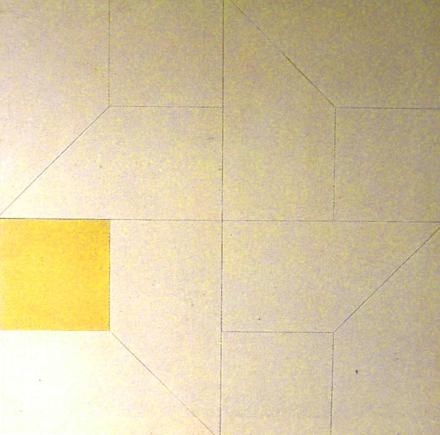
(left) Lygia Clark, Relief Painting with Yellow Square, oil, 1957, 30 in. H Brazilian Neoconcretism (right) compare: Kasimir Malevich, Suprematism, White on White, 1918

Slide 25
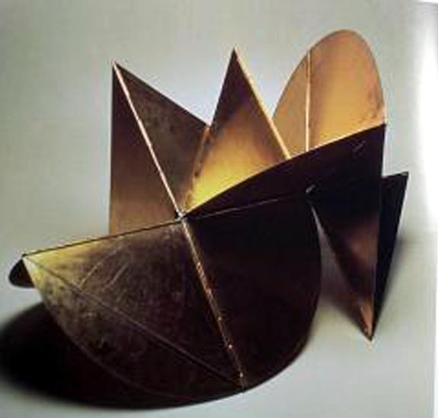
Lygia Clark, Machine Animal (Bicho), 1962, aluminum, 55x65, Sao Paulo

Slide 26
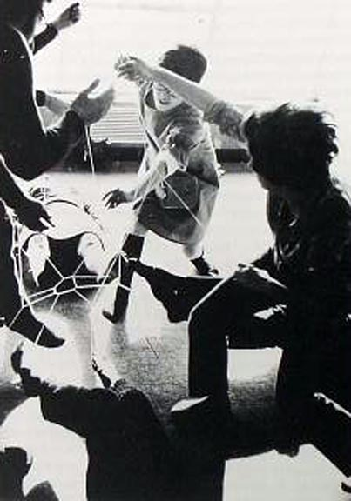
Lygia Clark, Mandala, from the series, Collective Body, 1959, elastic bands linking people at their wrists or ankles

Slide 27
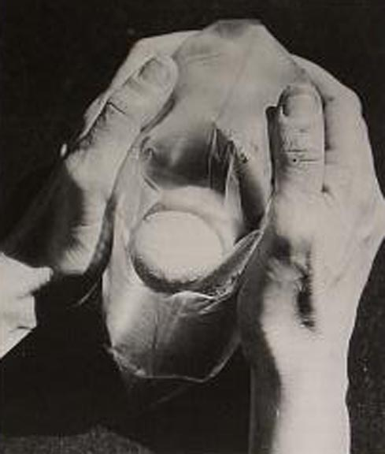
Lygia Clark, Air & Stone (Multiple) 1966, inflated plastic bag and stone

Slide 28
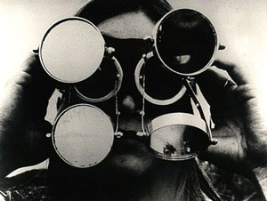
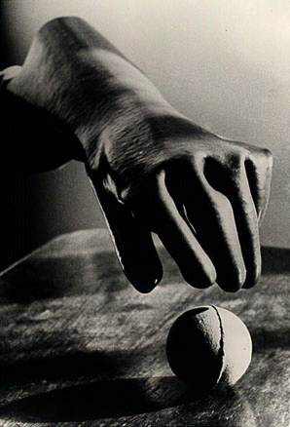
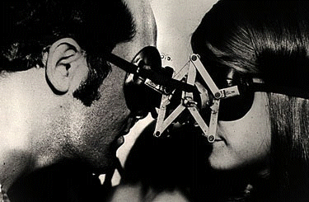
(left) Lygia Clark, Mask with Mirrors, 1967; (below) Dialogue, 1968 The mask holds small movable mirrors in front of the eyes, juxtaposing and fracturing reflections of the self and the surrounding world. (right) Clark, Sensorial Gloves, 1968. Part of Nostalgia of the Body series. Gloves are made of various materials, sizes and textures. Participants use the many combinations of gloves and balls of different sizes, textures and weights, and then hold the balls again with bare hands. Purpose is to rediscover keen sensation.

Slide 29
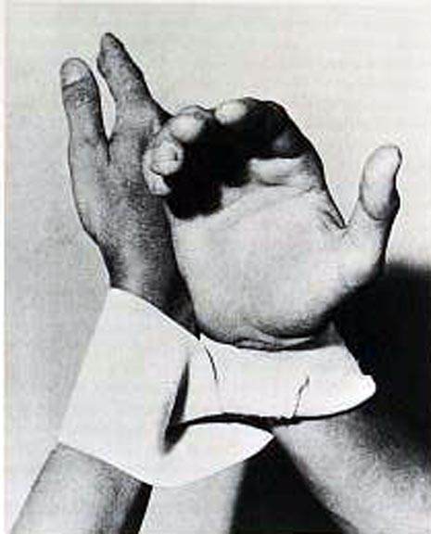
Lygia Clark and Helio Oiticica, Dialogue for Hands, 1966 elastic Möbius band Elastic Möbius band “Helio and I are like a glove. He is the outside of the glove, very much linked to the exterior world. I am the inside. And the two of us exist from the moment there is a hand which puts on the glove” (Lygia Clark ) http://www.cut-the-knot.org/do_you_know/moebius.avi

Slide 30
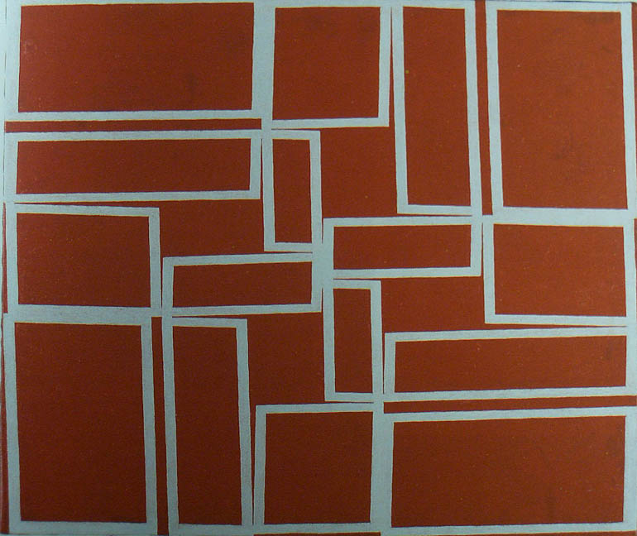
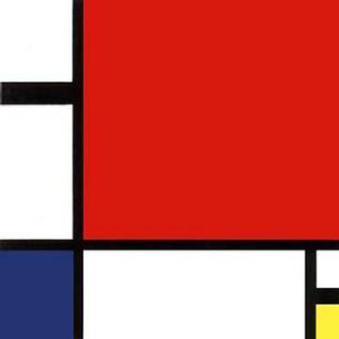
(left) Hélio Oiticica (Brazil, 1937-1980), White Crossing Red – Metaschema 1968, oil, 21 in. H; compare Piet Mondrian, Tableau, 1921, Neoplasticism

Slide 31
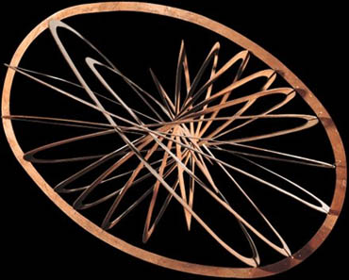
(left) Hélio Oiticica, Spatial Relief, 1959, synthetic polymer paint on wood, 38 x 48 x 8” (right) Alexander Rodchenko, Spatial Relief, 1920, Russian Constructivism

Slide 32
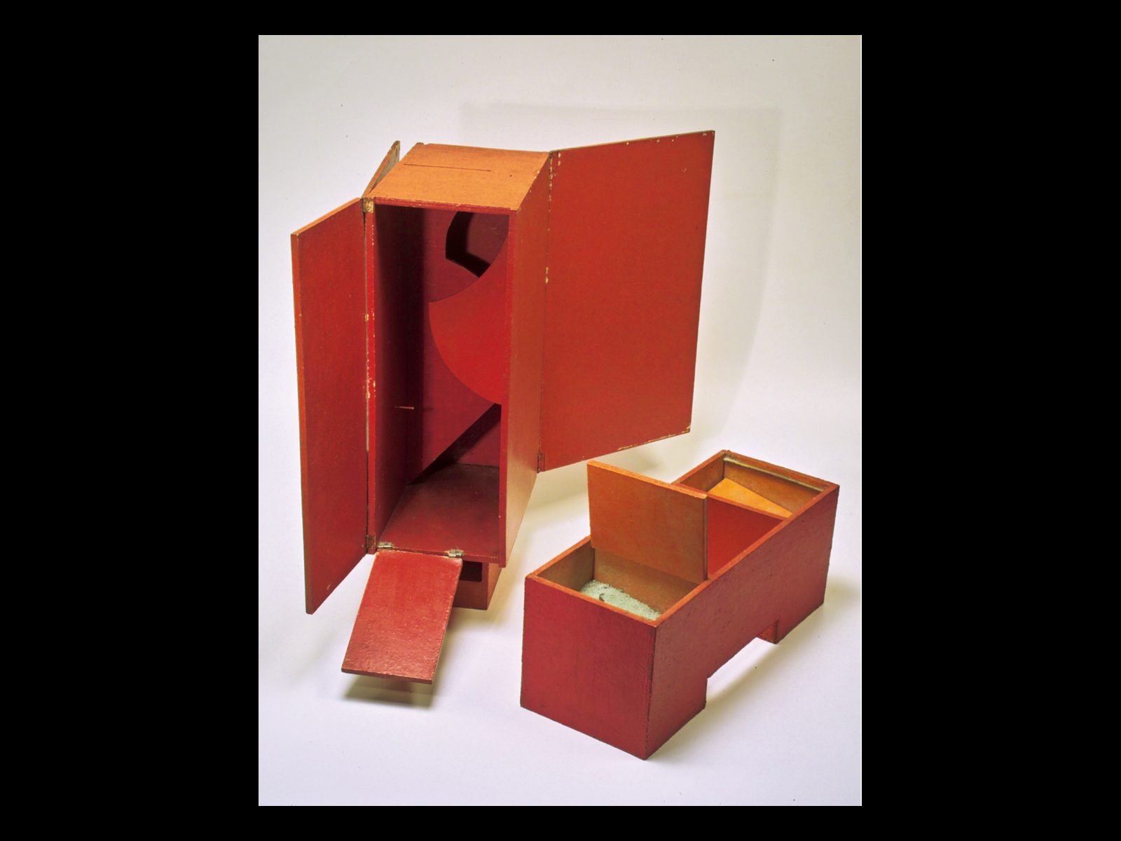
Hélio Oiticica, B3 Bólide Box 3 “Africana,” 1963. Oil on wood, 23 5∕8 x 9 3∕8 x 11 3∕4" (59.9 x 23.8 x 30 cm). Image courtesy Projecto Hélio Oiticica.
Notes:
1.7 Hélio Oiticica, B3 Bólide Box 3 “Africana,” 1963. Oil on wood, 23 5∕8 x 9 3∕8 x 11 3∕4" (59.9 x 23.8 x 30 cm). Image courtesy Projecto Hélio Oiticica.

